Slide 1
Classification of price range of Mobile + GUI
Team Name : Runtime Error
Team Members :
Yatin Aggarwal (CSE)
Sandeep Singh (CSE)

Slide 2

Outline
Introduction
Scientific Goal
Dataset Description
Preprocessing of Data
Data Visualisation
Splitting the dataset
Using ML Models
Accuracy using ML models
Using Decision Tree
GUI
Importing and checking the data in GUI
Classification
Conclusion

Slide 3
Introduction
Nowadays, Mobile is an important device for every person
The competition in the mobile sector has been growing rapidly.
Price of mobile heavily depends upon its specifications like RAM, battery, storage capacity, number of processors, Display Size, Screen Resolution, Camera Quality and many more things.
Every company wants a competitive price of it’s mobile in the market.

Slide 4

Scientific Goal
The goal of this project is to help the companies to set an appropriate Price of their mobile which will help them to maximize their profit on that mobile which they want to launch.

Slide 5
Dataset Description
Dataset has following 40 attributes (taken from kaggle.com)
brand, model, network_technology, 2G_bands, 3G_bands, 4G_bands, network_speed, GPRS, EDGE, announced, status, dimentions, weight_g, weight_oz, SIM, display_type, display_resolution, display_size, OS, CPU, Chipset, GPU, memory_card, internal_memory, RAM, primary_camera, secondary_camera, loud_speaker, audio_jack, WLAN, bluetotth, GPS, NFC, radio, USB, sensors, battery, colors, approx_price_EUR, img_url
Dataset is of JUNE 2017

Slide 6
Cleaned Dataset Description
Dataset has following attributes :
3G_bands : 3G support (0 or 1)
4G_bands : 4G support (0 or 1)
GPRS : GPRS support (0 or 1)
EDGE : Enhanced Data for Global Evolution (0 or 1)
thickness : thickness of the mobile
weight_g : weight of mobile in grams
display_size : display size (diagonal in inches)
display_ppi : pixels per inch
n_cores : number of cores (single core, dual core, quad core, hexa core, octa core, deca core)
internal_memory : internal storage of mobile (in GB)
RAM : RAM of mobile (in GB)
primary_camera : primary camera of mobile (in MP)
secondary_camera : secondary camera of mobile (in MP)
battery : battery capacity (in mAh)
approx_price : approx price of mobile (in Rs)

Slide 7
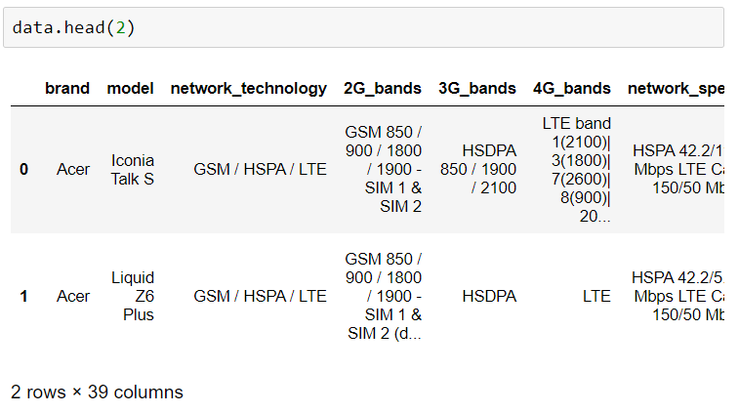
Preprocessing of Data
Print the first two rows of the dataset

Slide 8

Removing insignificant columns
Removing those columns which are insignificant

Slide 9
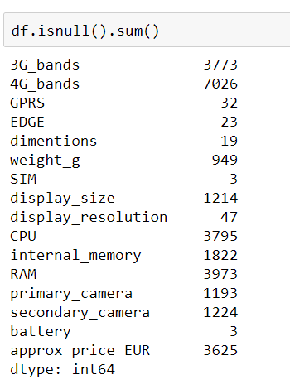
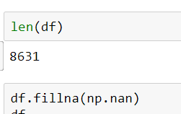
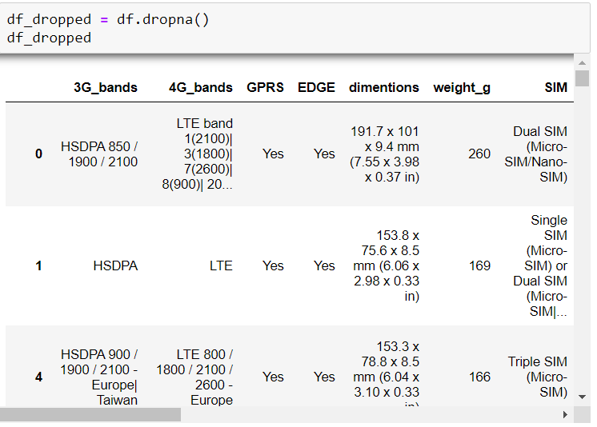
Checking for missing values and removing rows with missing values
Removing those rows which have missing values

Slide 10
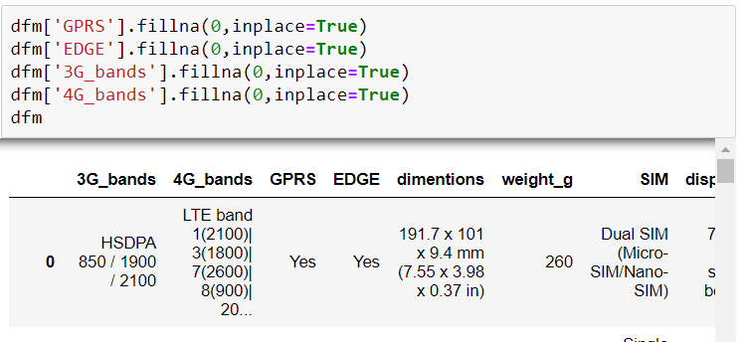
Filling Null Values with 0

Slide 11
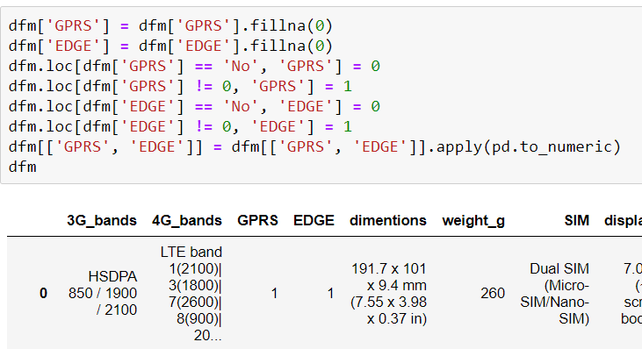
Changing the values (Yes/No to 1/0)
Changing the values for easy visualisation

Slide 12
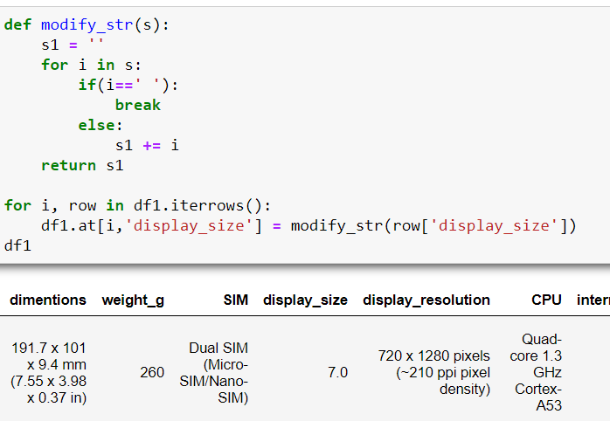
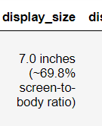
Modifying the Column Data of ‘Display Size’
Modifying the column data as per our requirement,
E.g.
To 7.0

Slide 13
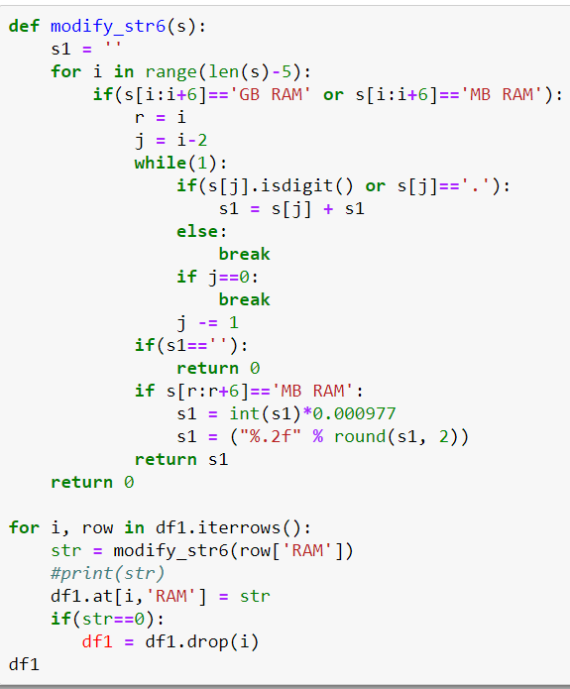


Modifying the Column Data of ‘RAM’
Formatting the data of the column ‘RAM’ to make the datatype compatible for easy visualisation.

Slide 14
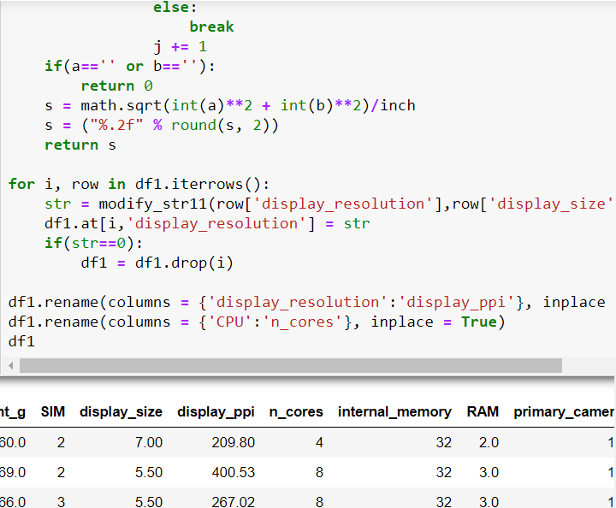
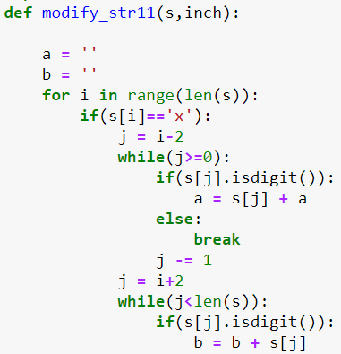
Modifying the Column ‘Display_resolution’
Changing the column of Display Resolution to Display PPI for better understanding.

Slide 15
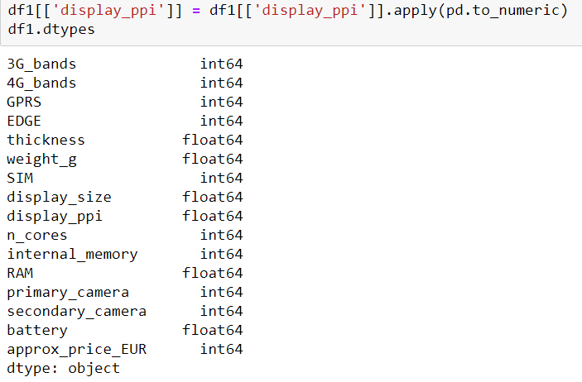
Changing the Datatypes
Changing the datatypes for compatibility of columns with each other.
Now, all the columns have compatible datatypes and can be easily visualised.
Thus, our dataset is ready for Visualisation.

Slide 16
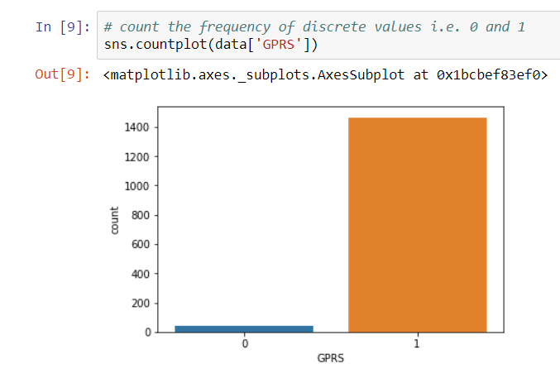
DATA VISUALISATION

Slide 17
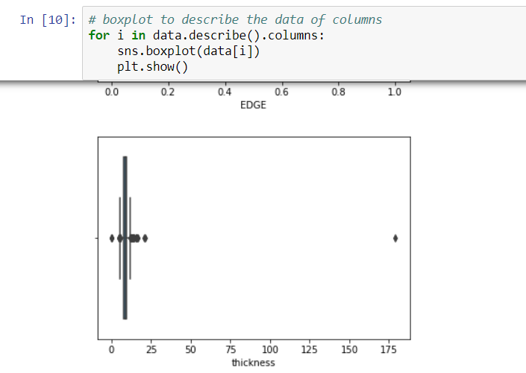
Describing the data of column
thickness can't be more than 50mm or less than 1mm

Slide 18
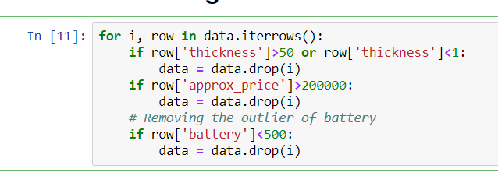
REMOVING OUTLIERS
As thickness can’t be more than 50mm and not less than 1mm and approx_price should not be more than Rs 200000, and battery capacity should not be less than 500mAh

Slide 19
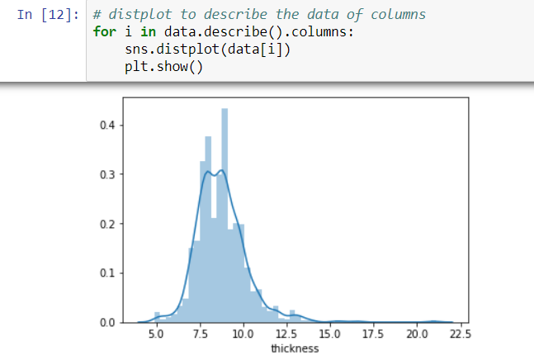
Using Distplot to check the variation of thickness
We can observe that most of the mobiles have thickness between 6mm and 11mm

Slide 20
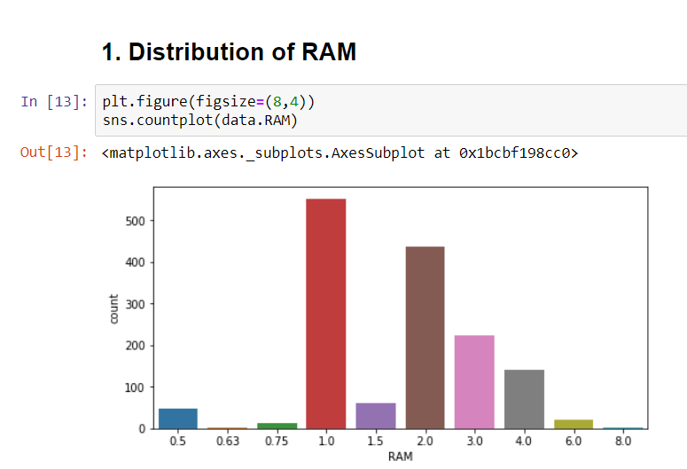
UNIVARIATE ANALYSIS
It depicts that 1GB and 2GB RAM mobiles are larger in number

Slide 21
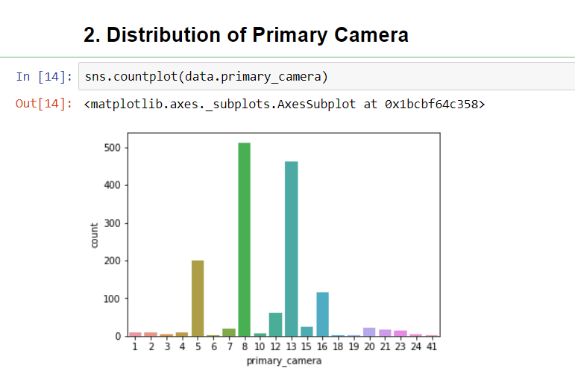
It depicts that 8MP and 13MP Primary Camera mobiles are larger in number

Slide 22
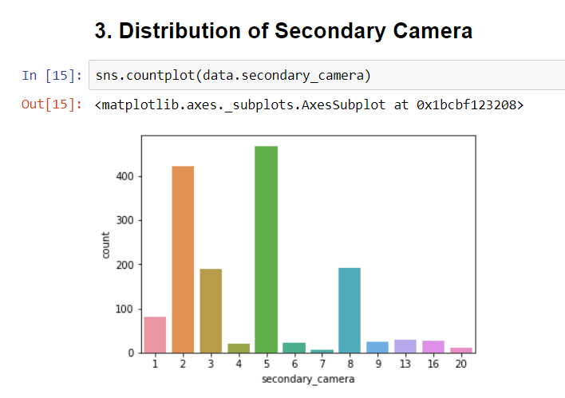
It depicts that 2MP and 5MP Secondary Camera mobiles are larger in number

Slide 23
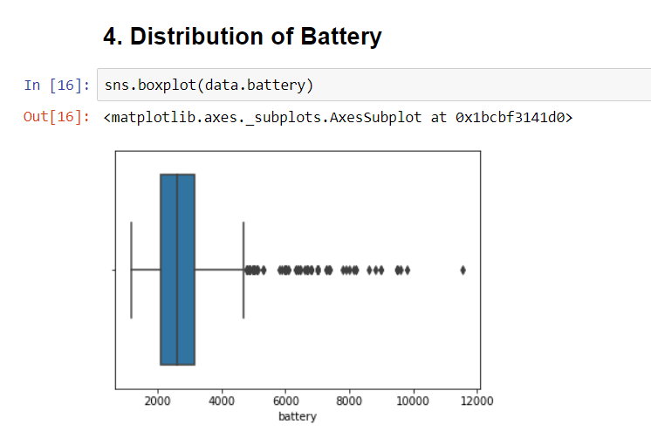
25% quartile is near 2000, median is around 2500 and 75% quartile is around 3000.

Slide 24
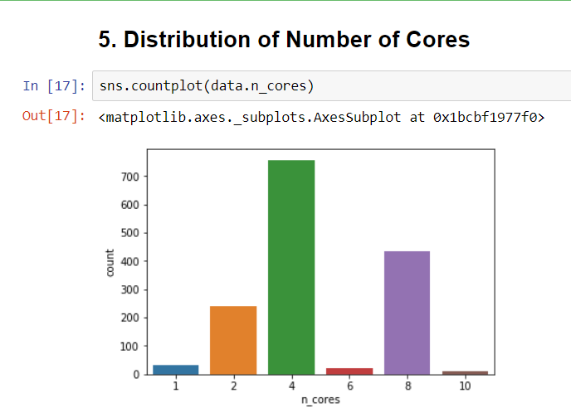
It depicts that quad-core is the most demanded

Slide 25
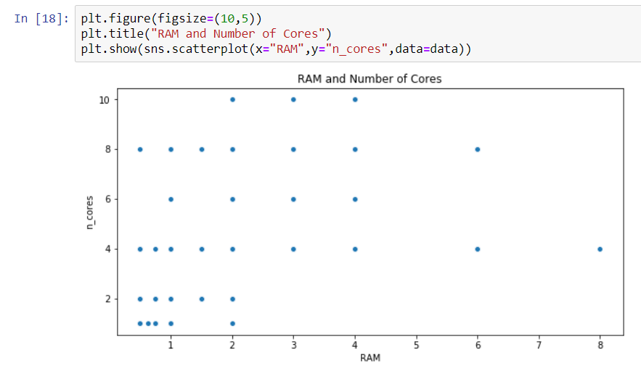
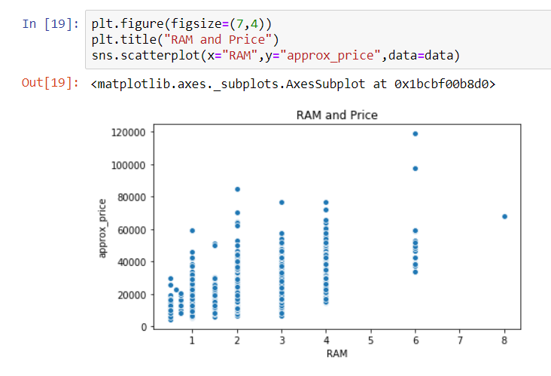
BIVARIATE ANALYSIS
Analysis of RAM and n_cores Analysis of RAM and Price

Slide 26
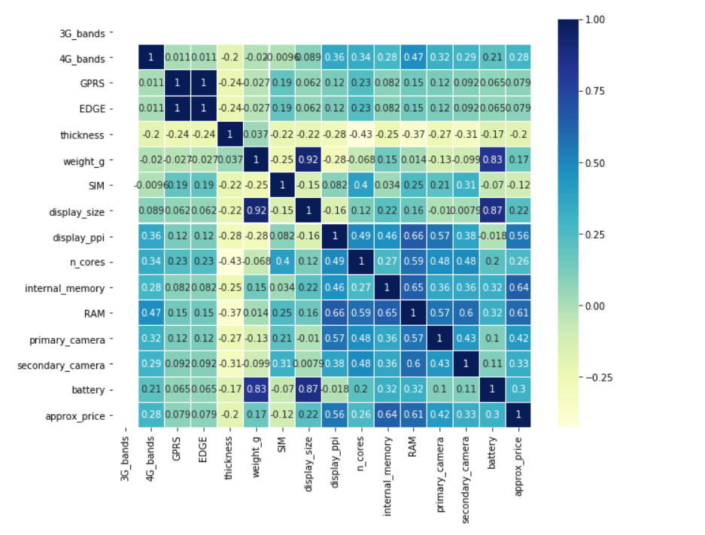
CORRELATION MATRIX
(In the form of Heat map)

Slide 27
This gives us the strong Co-Relation B/W Following:
There is weak relation between thickness and all other columns except weight(in grams)
The strongest co-relation is between Display Size and weight_g.
I.e. 0.92
The weakest co-relation is between thickness and n_cores
I.e. -0.43
GPRS and EDGE
Weight and Display Size
Weight and Battery
Display Size and Battery

Slide 28

Splitting the dataset
We have splitted the dataset into train and test dataset
80% of our data is used as data_train for training and 20% of our data is used as data_test for testing

Slide 29
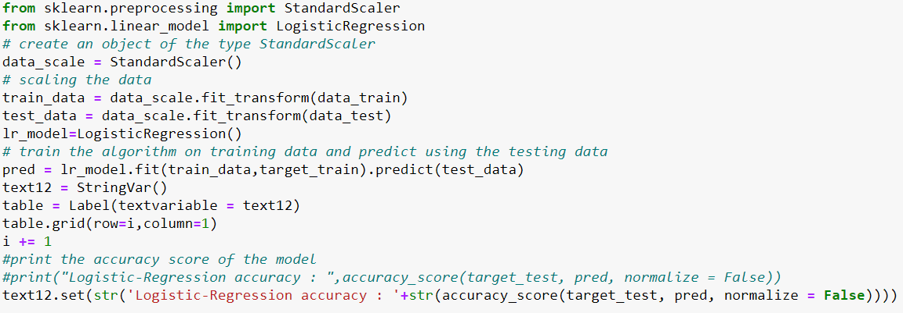
Using ML Models
Here, we have used Logistic Regression to predict the accuracy.

Slide 30
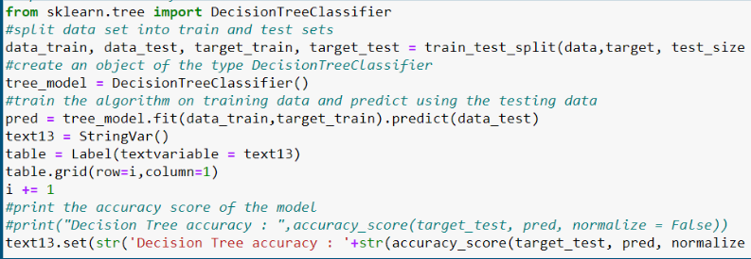
Using ML Models
Here, we have used Decision Learning Algorithm to predict the accuracy.

Slide 31
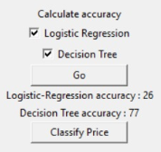
Accuracy using ML models
Highest Accuracy is 77 using Decision Learning Model
The accuracy using Logistic-Regression is 26

Slide 32
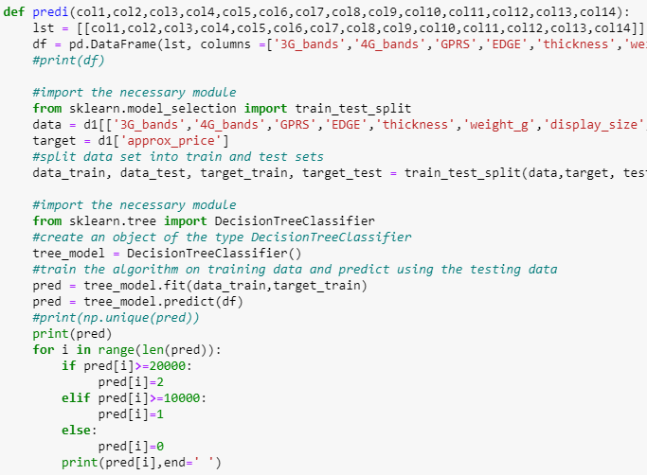
Using Decision Tree
Using Decision tree, we take input of all the features of a mobile and classify them according to their predicted price.

Slide 33
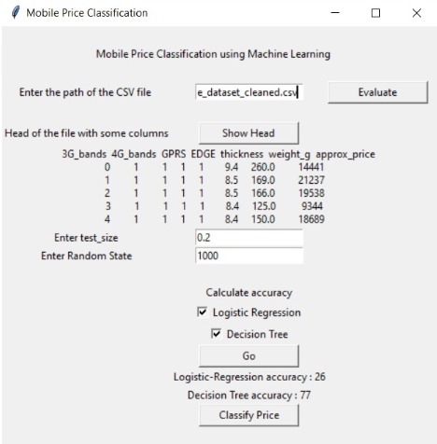
GUI using Tkinter
Tkinter is the standard GUI library for python.
Python when combined with Tkinter provides a fast and easy way to create GUI applications.

Slide 34
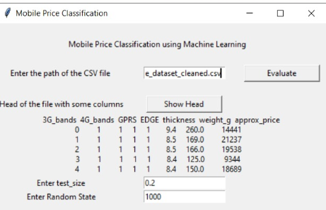
Importing and checking the data in GUI
First, we have to enter the path of the CSV file and then click on the ‘Evaluate’ button to import
Using ‘Show Head’ button we can confirm the data by checking its head

Slide 35
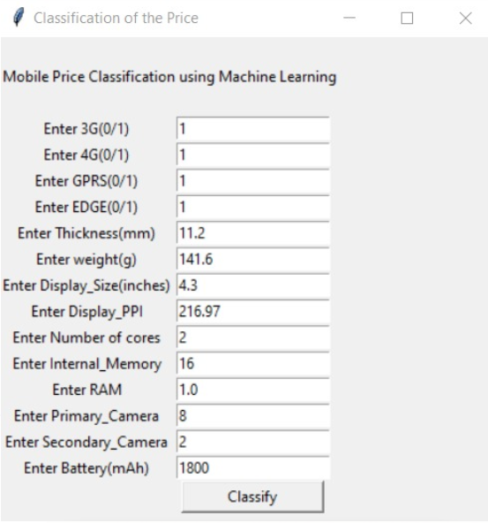
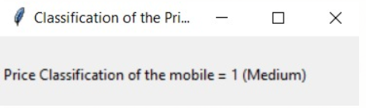
Classification
It takes all the attributes and displays the price classification.
0 - Low
1 - Medium
2 - High

Slide 36
Conclusion
This project analyses the specifications of the mobiles.
It gives us the classification of the price which a company should set according to the features of the mobile which the company wants to launch so as to minimize the loss and maximize the profit.

Slide 37
Thank You

